Slide 1

Storage Systems
Lars Ailo Bongo Inf-2201, University of Tromsø, Spring 2019

Slide 2
Big Data Sources
Voluntary human produced content
Videos, photos, audio…
Involuntary produced content
Online activity logging, tax records…
Scientific instruments
CERN LHC, Sloan Digital Sky Survey, brain simulations, DNA sequencers…

Slide 3
Big Data
How big?

Slide 4
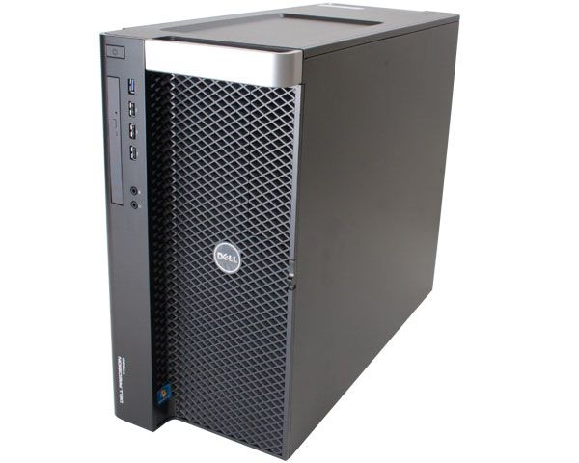


Dataset Size
< 8GB
< 1TB
TBs
PBs

Slide 5
Dataset Size (NxM)
Billions of samples & few dimensions, or
Billions of samples & thousands of dimensions, or
Thousands of samples & thousands of dimensions

Slide 6




Data Analysis Framework

Slide 7


Computation Time
<100ms
seconds
minutes
hours
weeks

Slide 8
Optimizations
R or Matlab implementation
Algorithm parameter tuning
C++/ Java / … implementation
Data structure optimization
Multi-threaded parallelization (single machine)
Distributed parallelization (multiple-machines)

Slide 9
Notes:
Published in 2009
Jim Gray’s talk 2007
Empirical
Theoretical
Computational
Data exploration

Slide 10
Data challenges

Slide 11
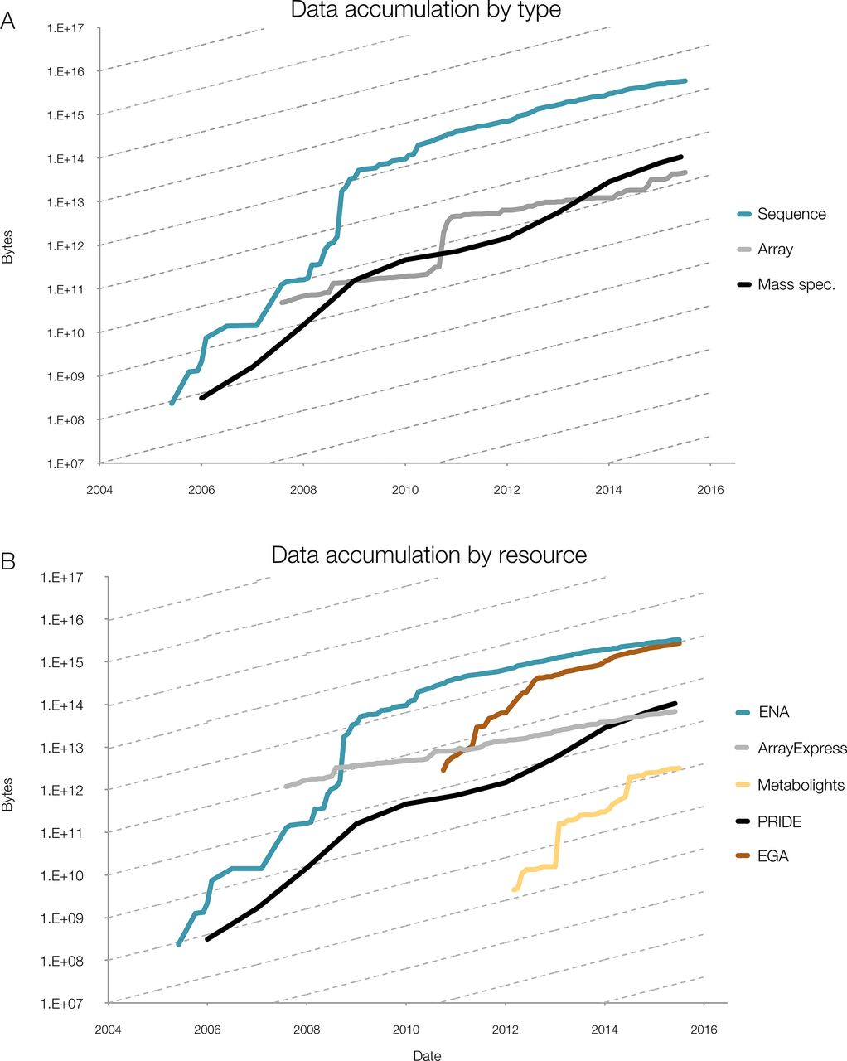
Data growth in the life sciences
Data growth at EMBL-EBI
Source: Charles E. Cook et al. Nucl. Acids Res. 2016;44:D20-D26
Notes:
Phenomenal data growth – dotted lines represents doubling every twelve months
(A) Data accumulation at EMBL-EBI by data type, for example mass spectrometry (MS); (B) Data accumulation by dedicated resource, for example PRIDE. The y-axis is log-scale, with the slope of the dashed lines indicating a 12-month doubling time. Continued data growth is seen in all types of data at EMBL-EBI and all data resources. In all data resources shown here, growth rates are predicted to continue increasing, with notable sustained exponential growth in PRIDE, the European Genome-phenome Archive (EGA) and MetaboLights: all have doubling times of around 12 months. All three contributing platforms show rates that are increasing over time, with data growing exponentially with around a 12-month doubling time.

Slide 12
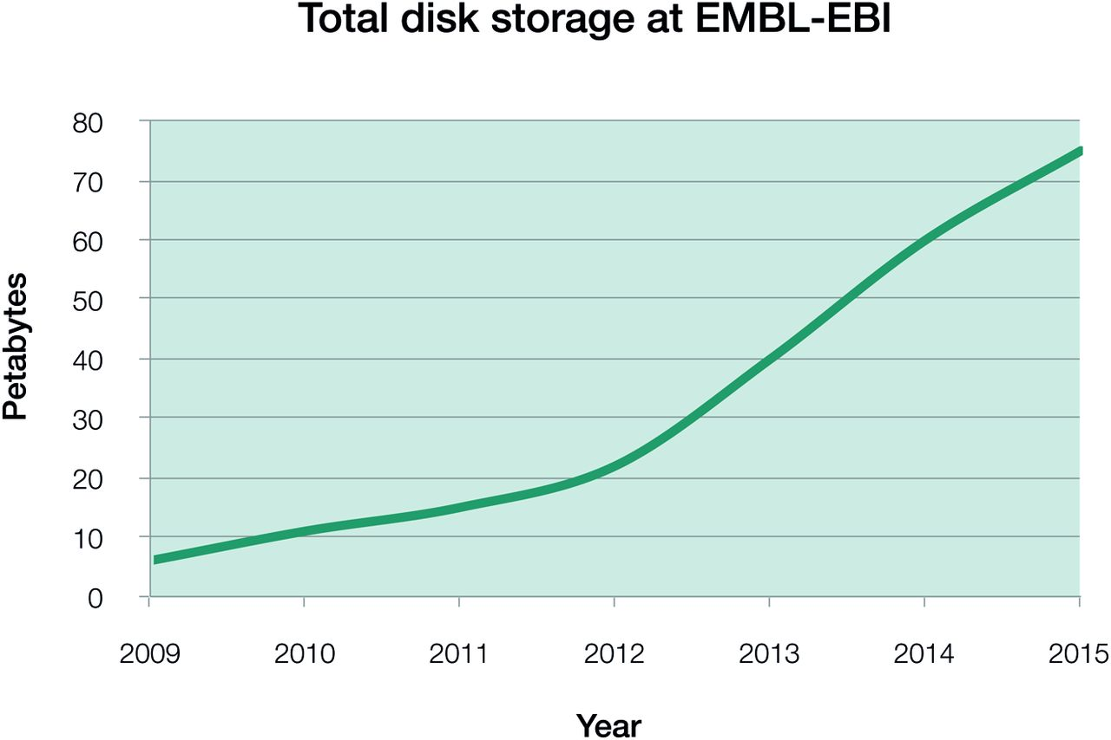
The data challenge: Data growth
Computer speed and storage capacity is doubling every 18 months and this rate is steady
DNA sequence data is doubling every 6-8 months over the last 3 years and looks to continue for this decade
Source: Charles E. Cook at al. Nucl. Acids Res. 2016; 44: D20-D26

Slide 13
Data resources in life science
molecular biology
data resources
Nucleic Acids Research annual Database Issue
and the NAR online Molecular Biology Database Collection in 2012.
MY Galperin, GR Cochrane – Nucleic Acids Research, 2011
~1800

Slide 14
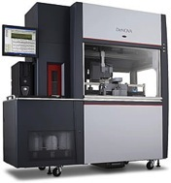
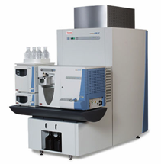
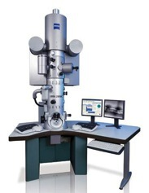
We generate data faster than we can deposit it
Network file transfer rate
24 hours
100 Mb
DNA sequencing
~100 GB
~5 hours
Mass spectrometry
~4 TB
~4 days
Microscopy
~4 TB
~4 days
14
Notes:
We are generating data faster than we can transfer it.
Even with faster lines we are talking major computational bottlenecks in file transfer.
Technology get cheaper and faster
~15.000 hospital
~4.000 universities
~2.000 life sciences research institutes
How much data we will produce? How we will store it?

Slide 15
Overview
Magnetic disks
Disk arrays
Flash storage
DRAM storage
Storage hierarchy

Slide 16
Storage
Reliability
Archival
Reliable
Persistent
Temporal
Access pattern
Write or read intensive
Sequential or random access
Low-latency or high throughput
Cost
Power

Slide 17
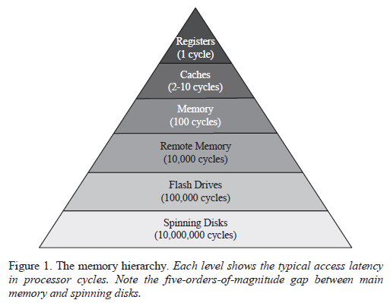
The Memory Hierarchy
Jiahua He, Arun Jagatheesan, Sandeep Gupta, Jeffrey Bennett, Allan Snavely, "DASH: a Recipe for a Flash-based Data Intensive Supercomputer," sc, pp.1-11, 2010 ACM/IEEE International Conference for High Performance Computing, Networking, Storage and Analysis, 2010

Slide 18
Disk vs. Flash vs. DRAM
 | Disk | Flash | DRAM
Access time (relative) | 1 | 100-1,000 | 0.000001 (1 / 100,000)
Cost (relative) | 1 | 15-25 | 30-150
Bandwidth (relative) | 1 | 1 | 80
Bandwidth/ GB (relative) | 1 |  | 6,000
Bandwidth/ $ (relative) | 1 |  | 160
Source: Computer Architecture A Quantitative Approach

Slide 19
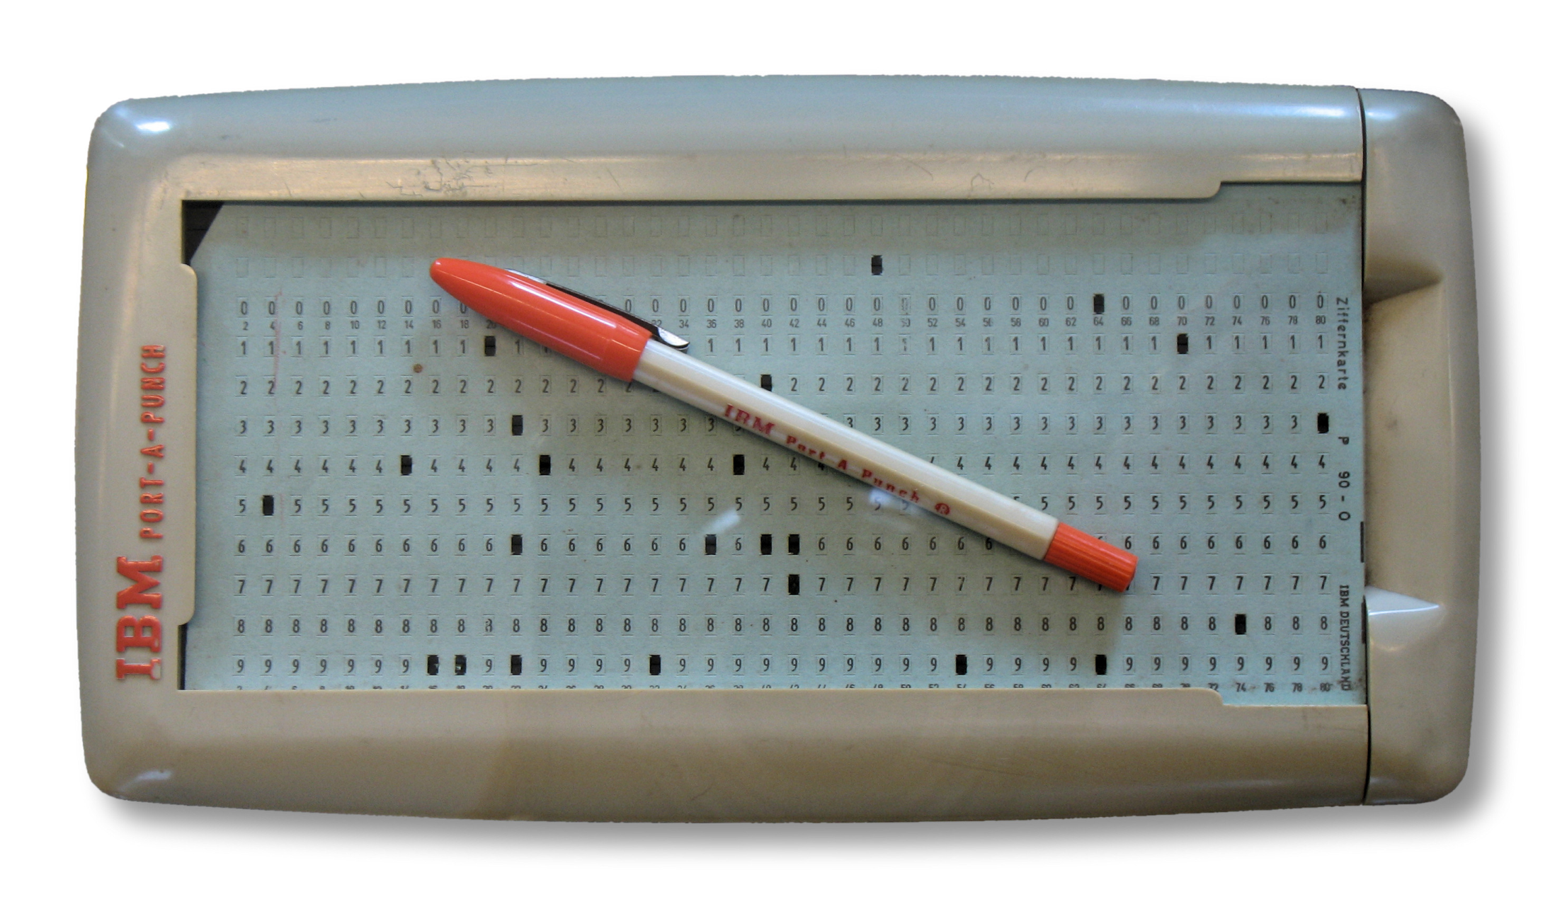
Punch Cards

Slide 20
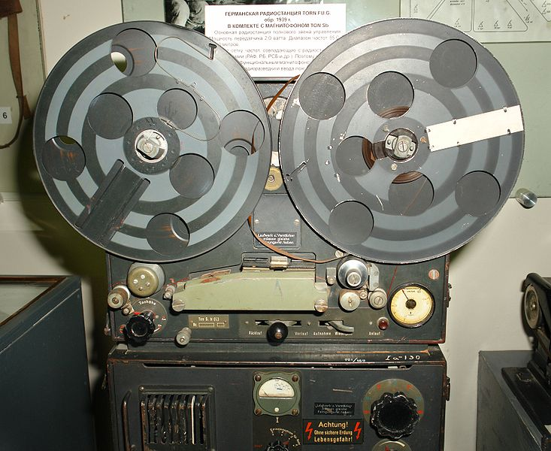
Magnetophone

Slide 21
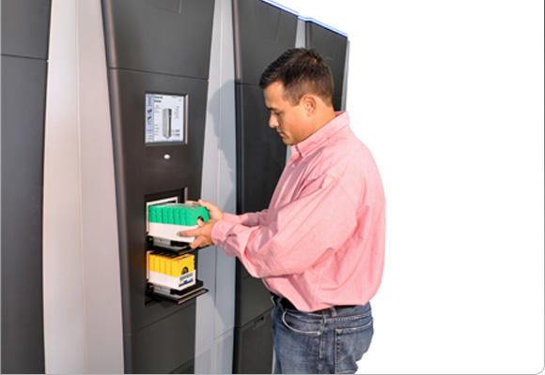
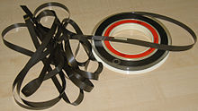
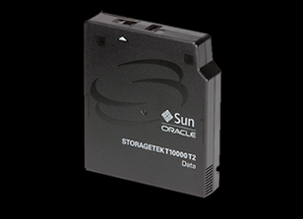
Tape Library
Notes:
First used: 1951 in UNIVAC-1
Picture: Spectra T-Finity, with 400PB capacity
Tape: Oracle T10000C: 5TB capacity, 250MB/s uncompressed write ratio
Driver typically compress data: 2x ratio

Slide 22
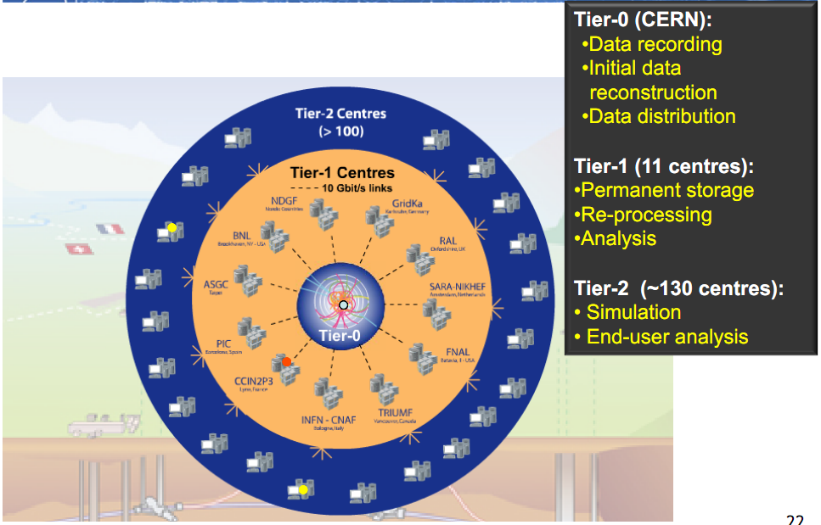
Scientific Storage Systems
Source: http://www.usenix.org/events/lisa10/tech/slides/cass.pdf

Slide 23
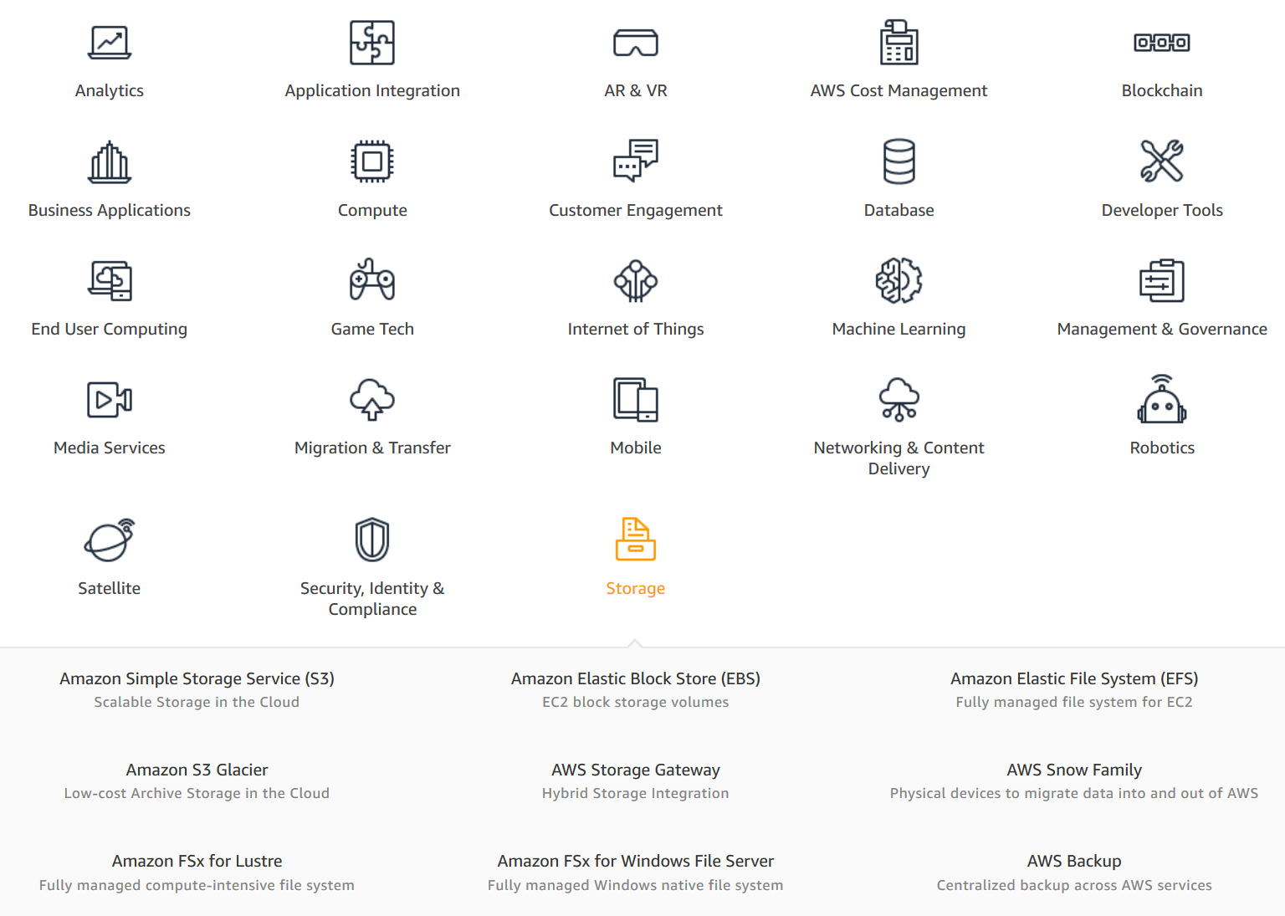

Slide 24
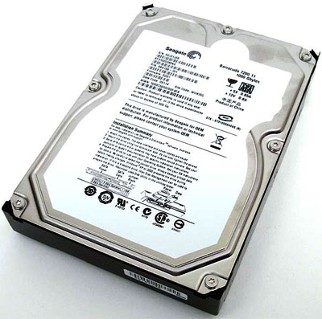
Hard Drive Teardown
http://www.youtube.com/watch?v=Wiy_eHdj8kg

Slide 25
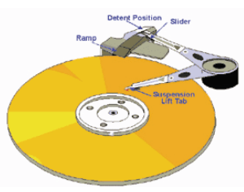
Disk Arm and Head
Disk arm
A disk arm carries disk heads
Disk head
Mounted on an actuator
Read and write on disk surface
Read/write operation
Disk controller receives a command with <track#, sector#>
Seek the right cylinder (tracks)
Wait until the right sector comes
Perform read/write

Slide 26
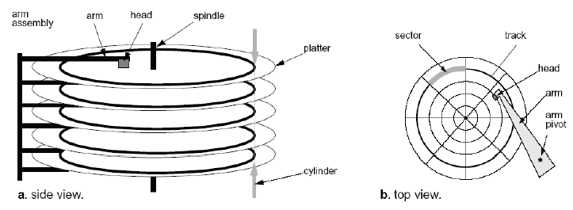
Mechanical Component of A Disk Drive
Tracks
Concentric rings around disk surface, bits laid out serially along each track
Cylinder
A track of the platter, 1000-5000 cylinders per zone, 1 spare per zone
Sectors
Each track is split into arc of track (min unit of transfer)

Slide 27
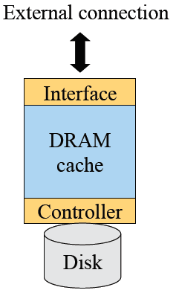
A Typical Magnetic Disk Controller
External connection
Parallel ATA (aka IDE or EIDE), Serial ATA, SCSI, Serial Attached SCSI (SAS), Fibre Channel, FireWire, USB
Cache
Buffer data between disk and interface
Controller
Read/write operation
Cache replacement
Failure detection and recovery

Slide 28
Disk Caching
Method
Use DRAM to cache recently accessed blocks
Most disks has 32MB
Some of the RAM space stores “firmware” (an embedded OS)
Blocks are replaced usually in an LRU order
Pros
Good for reads if accesses have locality
Cons
Cost
Need to deal with reliable writes

Slide 29
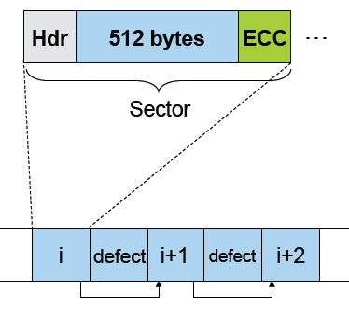
Disk Sectors
Where do they come from?
Formatting process
Logical maps to physical
What is a sector?
Header (ID, defect flag, …)
Real space (e.g. 512 bytes)
Trailer (ECC code)
What about errors?
Detect errors in a sector
Correct them with ECC
If not recoverable, replace it with a spare
Skip bad sectors in the future

Slide 30
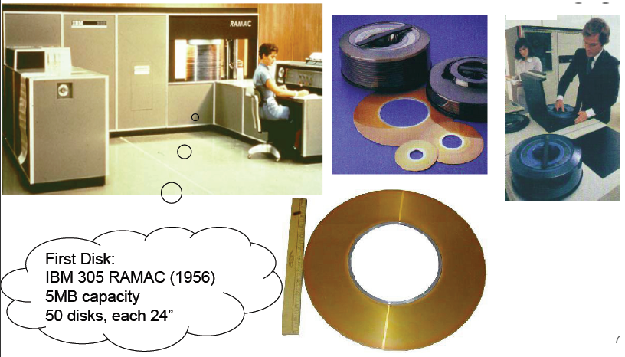
Disks Were Large

Slide 31
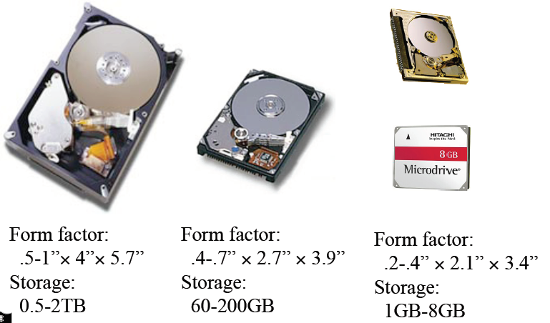
They Are Now Much Smaller
Notes:
3.5” 0.5-3TB
2.5” 320-640

Slide 32
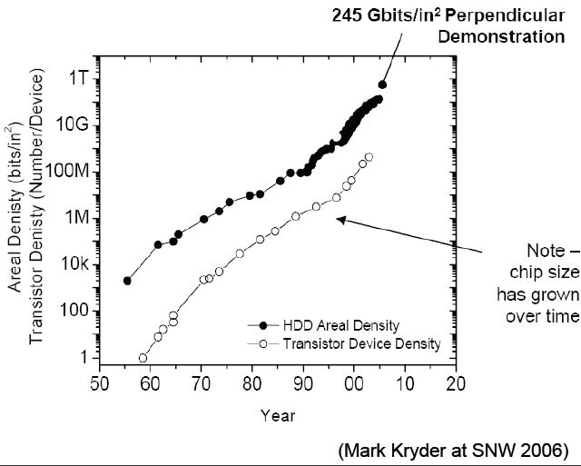
Areal Density vs. Moore’s Law

Slide 33
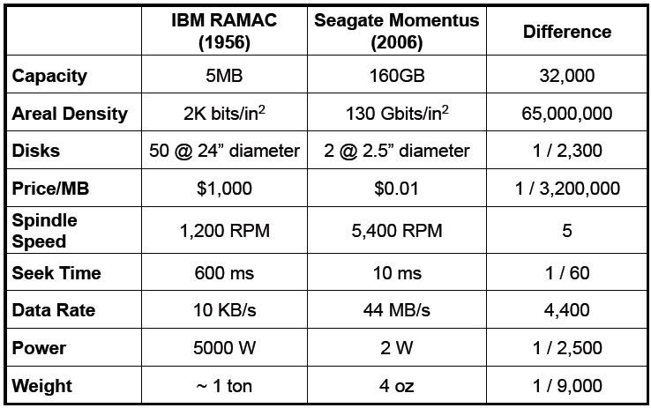
50 Years Later (Mark Kryder at SNW 2006)

Slide 34
Sample Disk Specs (from Seagate)
 | Cheetah 15k.7 | Barracuda XT
Capacity
Formatted capacity (GB) | 600 | 2000
Discs | 4 | 4
Heads | 8 | 8
Sector size (bytes) | 512 | 512
Performance
External interface | Ultra320 SCSI, FC, S. SCSI | SATA
Spindle speed (RPM) | 15,000 | 7,200
Average latency (msec) | 2 | 4.16
Seek time, read/write (msec) | 3.5/3.9 | 8.5/9.5
Track-to-track read/write (msec) | 0.2-0.4 | 0.8/1.0
Internal transfer (MB/sec) | 1,450-2,370 | 600
Transfer rate (MB/sec) | 122-204 | 138
Cache size (MB) | 16 | 64
Reliability
Recoverable read errors | 1 per 1012 bits | 1 per 1010 bits
Non-recoverable read errors | 1 per 1016 bits | 1 per 1014 bits

Slide 35
Disk Performance (2TB disk)
Seek
Position heads over cylinder, typically 3.5-9.5 ms
Rotational delay
Wait for a sector to rotate underneath the heads
Typically 8 - 4 ms (7,200 – 15,000RPM) or . rotation takes 4 - 2ms
Transfer bytes
Transfer bandwidth is typically 40-138 Mbytes/sec
Performance of transfer 1 Kbytes
Seek (4 ms) + half rotational delay (2ms) + transfer (0.013 ms)
Total time is 6.01 ms or 167 Kbytes/sec (1/360 of 60MB/sec)!

Slide 36
More on Performance
What transfer size can get 90% of the disk bandwidth?
Assume Disk BW = 60MB/sec, . rotation = 2ms, . seek = 4ms
BW * 90% = size / (size/BW + rotation + seek) size = BW * (rotation + seek) * 0.9 / 0.1= 60MB * 0.006 * 0.9 / 0.1 = 3.24MB
Seek and rotational times dominate the cost of small accesses
Disk transfer bandwidth are wasted
Need algorithms to reduce seek time
Speed depends on which sectors to access
Are outer tracks or inner tracks faster?
Block Size | % of Disk Transfer Bandwidth
1Kbytes | 0.28%
1Mbytes | 73.99%
3.24Mbytes | 90%

Slide 37
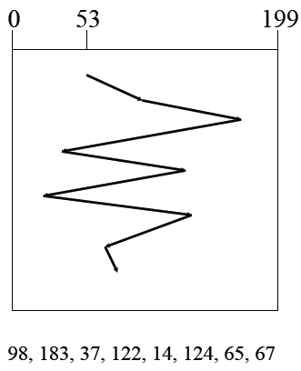
FIFO (FCFS) order
Method
First come first serve
Pros
Fairness among requests
In the order applications expect
Cons
Arrival may be on random spots on the disk (long seeks)
Wild swing can happen

Slide 38
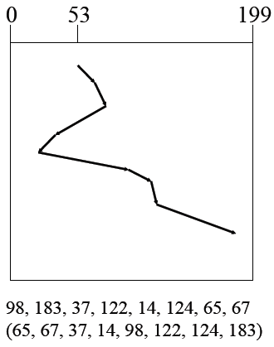
SSTF (Shortest Seek Time First)
Method
Pick the one closest on disk
Rotational delay is in calculation
Pros
Try to minimize seek time
Cons
Starvation
Question
Is SSTF optimal?
Can we avoid the starvation?

Slide 39
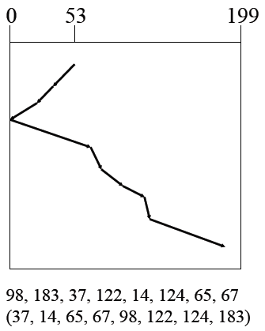
Elevator (SCAN)
Method
Take the closest request in the direction of travel
Real implementations do not go to the end (called LOOK)
Pros
Bounded time for each request
Cons
Request at the other end will take a while

Slide 40
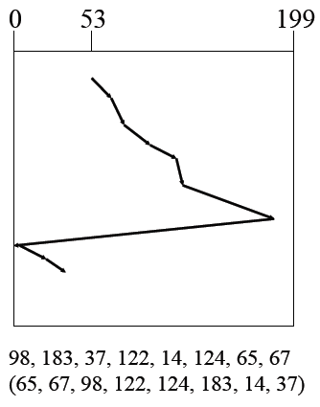
C-SCAN (Circular SCAN)
Method
Like SCAN
But, wrap around
Real implementation doesn’t go to the end (C-LOOK)
Pros
Uniform service time
Cons
Do nothing on the return

Slide 41
Discussions
Which is your favorite?
FIFO
SSTF
SCAN
C-SCAN
Disk I/O request buffering
Where would you buffer requests?
How long would you buffer requests?

Slide 42
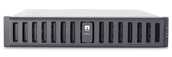
Storage System
Network connected box with many disks
Entry level box has 12 disks
Mean time to failure?
How to improve reliability?
What if there are 1000 disks?

Slide 43
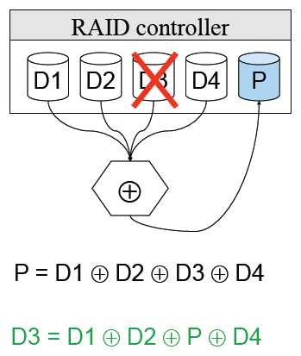
RAID (Redundant Array of Independent Disks)
Main idea
Store the error correcting codes on other disks
General error correcting codes are too powerful
Use XORs or single parity
Upon any failure, one can recover the entire block from the spare disk (or any disk) using XORs
Pros
Reliability
High bandwidth
Cons
The controller is complex

Slide 44
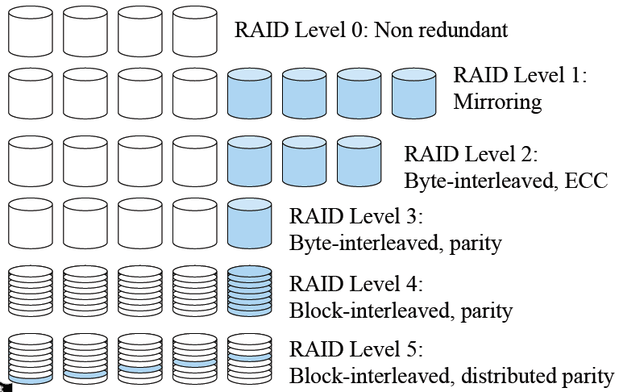
Synopsis of RAID Levels

Slide 45
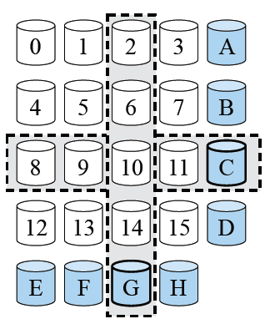
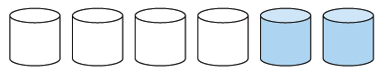
RAID Level 6 and Beyond
Goals
Less computation and fewer updates per random writes
Small amount of extra disk space
Extended Hamming code
Specialized Eraser Codes
IBM Even-Odd, NetApp RAID-DP, …
Beyond RAID-6
Reed-Solomon codes, using MOD 4 equations
Can be generalized to deal with k (>2) disk failures

Slide 46
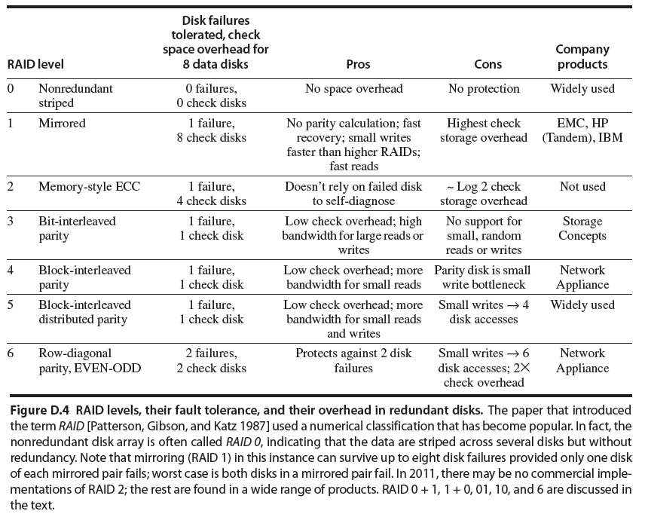
Figure from: Computer Architecture A Quantitative Approach

Slide 47
An Alternative to RAID
Google File System
Open source version: Hadoop file system
Distributed file system built on top of Linux FS
Special purpose for data-intensive computing (MapReduce)
Not intended to replace Linux FS for ordinary jobs
Run on commodity components (clusters)
Each node in cluster has storage and computation resources
High aggregate I/O bandwidth
Large blocks (64MB)
Typically 3x replication for blocks
MapReduce jobs

Slide 48
Dealing with Disk Failures
What failures
Power failures
Disk failures
Human failures
What mechanisms required
NVRAM for power failures
Hot swappable capability
Monitoring hardware
RAID reconstruction
Reconstruction during operation
What happens if a reconstruction fail?
What happens if the OS crashes during a reconstruction

Slide 49
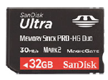
Next Generation: FLASH
Flash chip density increases on the Moore’s law curve
1995 16 Mb NAND flash chips
2005 16 Gb NAND flash chips
2009 64 Gb NAND flash chips
Doubled each year since 1995
Market driven by Phones, Cameras, iPod,… Low entry-cost, ~$30/chip → ~$3/chip
2012 1 Tb NAND flash == 128 Gb chip == 1TB or 2TB “disk” for ~$400 or 128GB disk for $40 or 32GB disk for $5
Retail prices as of March 2012:
Biggest SSD: 512 GB ($850)
128GB SSD for $230
(2TB disk about $200)
32GB SD: $90
Samsung prediction

Slide 50
NAND Flash Memory
https://www.youtube.com/watch?v=w3uwpuNY-Ww

Slide 51
Flash Memory
NOR
Byte addressable
Often used for BIOS
Much higher price than for NAND
NAND
Dominant for consumer and enterprise devices
Single Level Cell (SLC) vs. Multi Level Cell (MLC):
SLC is more robust but expensive
MLC offers higher density and lower price

Slide 52
NAND Memory Organization
Organized into a set of erase blocks (EB)
Each erase block has a set of pages
Example configuration for a 512 MB NAND device:
4096 EB’s, 64 pages per EB, 2112 bytes per page (2KB user data + 64 bytes metadata)
Read:
Random access on any page, multiple times
25-60μs
Write
Data must be written sequentially to pages in an erase block
Entire page should be written for best reliability
250-900 μs
Erase:
Entire erase block must be erased before re-writing
Up to 3.5ms

Slide 53
Flash Translation Layer
Emulate a hard disk by exposing an array of blocks
Logic block mapping
Map from logical to physical blocks
Cannot do random writes
Granularity: block vs. page (read-modify-write block vs. large RAM for storing map table
Hybrid approach often used: maintain a small set of log blocks for page level mapping
Garbage collection
Maintain an allocation pool of clean blocks (blocks must be erased before reuse)
Recycle invalidated pages
Merge blocks if page level mapping
Wear leveling
Most writes are to a few pages (metadata)
Even out writes over blocks

Slide 54
What’s Wrong With FLASH?
Expensive: $/GB
2x less than cheap DRAM
50x more than disk today, may drop to 10x in 2012
Limited lifetime
~100k to 1M writes / page (single cell)
~15k to 1M writes / page (single cell)
requires “wear leveling” but, if you have 1,000M pages, then 15,000 years to “use” the pages.
Current performance limitations
Slow to write can only write 0’s, so erase (set all 1) then write
Large (e.g. 128K) segments to erase

Slide 55
Current Development
Flash Translation Layer (FTL)
Remapping
Wear-leveling
Write faster
Form factors
SSD
USB, SD, Stick,…
PCI cards
Performance
Fusion-IO cards achieves 200K IOPS

Slide 56
Hardware/Software Architecture
Virtual File System
File System
File System
File System
Flash Storage Layer
Generic Block Layer
I/O Scheduler
Device Driver
Block Device Driver
Block Device Driver
SW (OS)
PCI-E
SATA
HW
Controller
Controller
Controller
SSD
SSD
HD

Slide 57
Discussions
Where to put a flash drive in the storage hierarchy?
Which new algorithms need to be developed?
Should the OS treat flash drive as a hard drive?

Slide 58
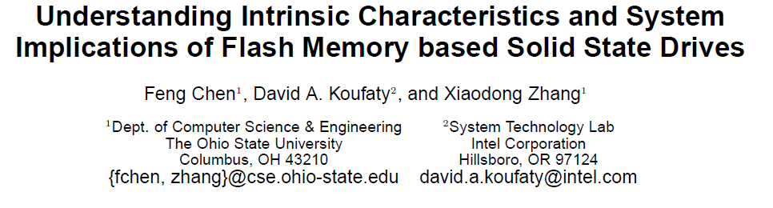
Good Paper
Following figures are from that paper

Slide 59
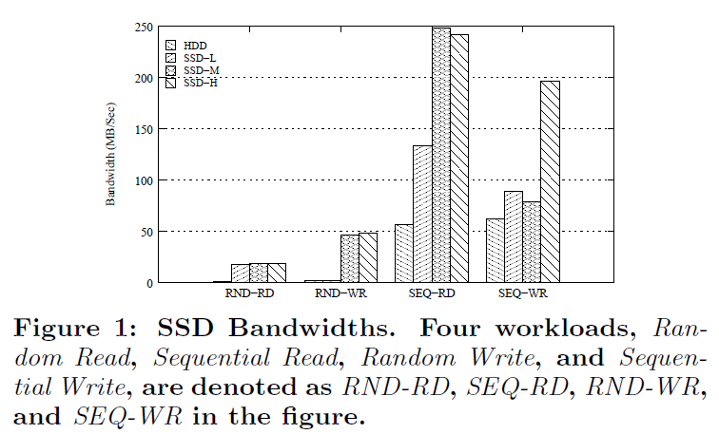
SSD Bandwidths (raw I/O)

Slide 60
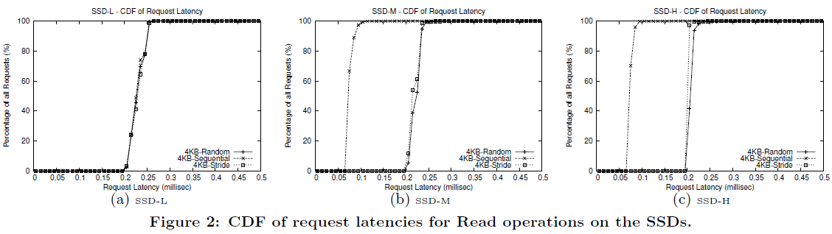
Do reads on SSD have uniform latency?
Figure 2

Slide 61
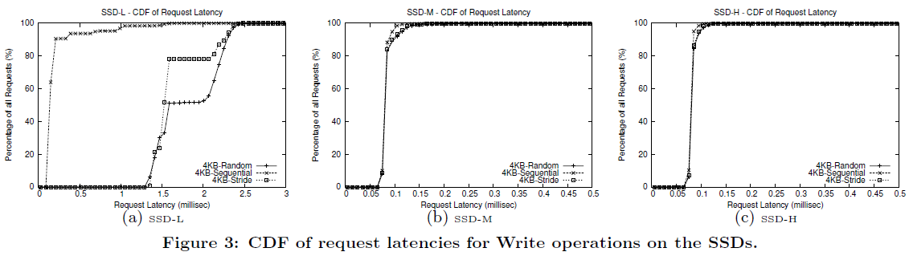
Would random writes be worst case?
Figure 3

Slide 62
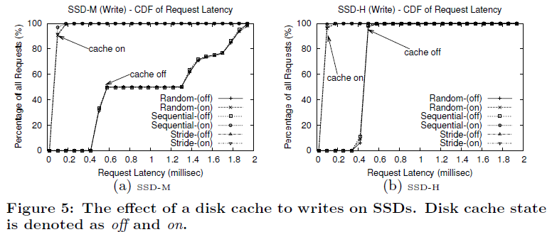
Is a disk cache effective for SSDs?
Fig. 5

Slide 63
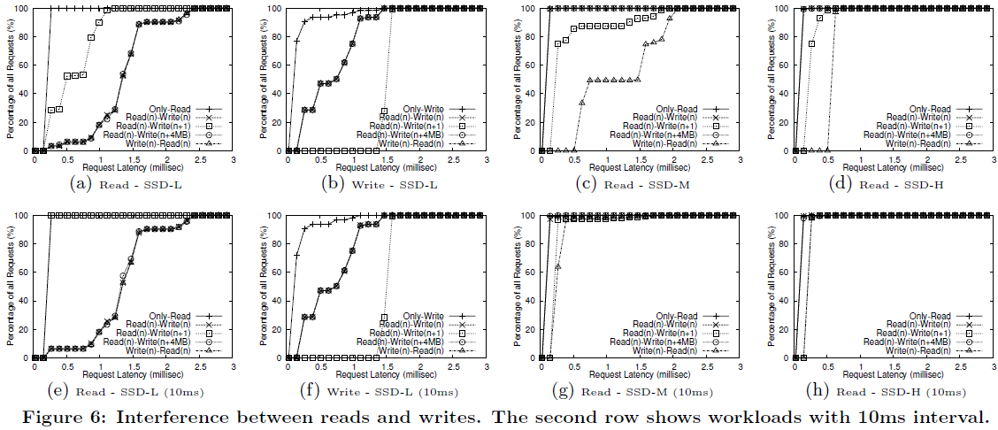
Do reads and writes interfere with each other?
Fig. 6

Slide 64
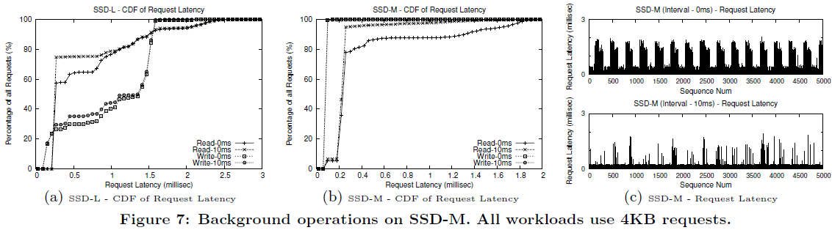
Do background operations affect performance?
Fig. 7

Slide 65
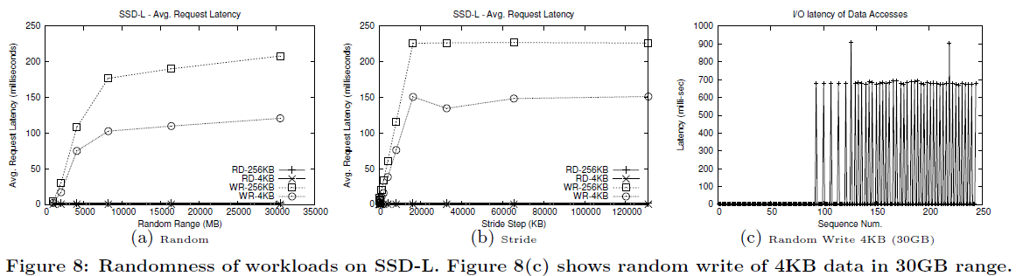
Would increasing workload randomness degrade performance?
Fig. 8

Slide 66
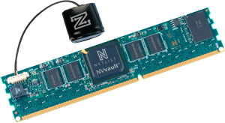
Non-volatile DRAM (NVRAM)
(Netlist Nvvault)
Battery backed DRAM
Backup power during power-out
Ordinary DRAM technology
One part of a storage system
Expensive
Targeted at specific application domains such as databases

Slide 67
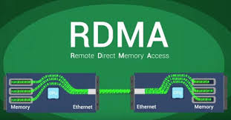
Remote Direct Memory Access

Slide 68
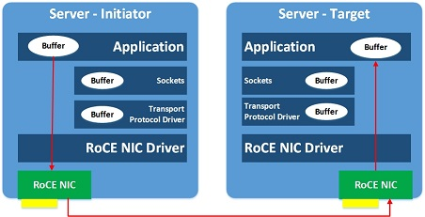
Low latency remote memory access

Slide 69
DRAM Storage Systems
Currently increasing interest in DRAM only storage systems
All data structures in memory
Data is backed on disk in background
In-memory databases
Database entirely in memory
Often used for analytics
Business critical data stored on ordinary databases
RAM Cloud
A big compute cluster
Data structures replicated over many computers
Data also written to disk
http://www.sigops.org/sosp/sosp11/current/2011-Cascais/03-ongaro-online.pdf

Slide 70
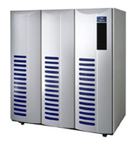
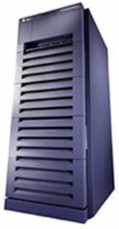
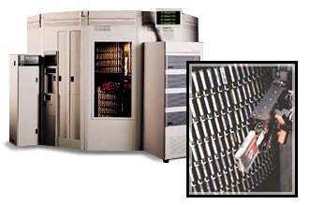
Traditional Data Center Storage Hierarchy
Network
SAN
…
Remote mirror
Storage
Server
Clients
Storage
Offsite backup
Onsite Backup

Slide 71
Evolved Data Center Storage Hierarchy
Network
…
Remote mirror
Network Attached Storage (NAS)
w/ snapshots to protect data
Clients
Storage
Offsite backup
Onsite Backup

Slide 72
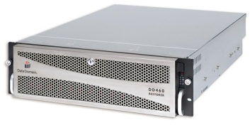

Modern Data Center Storage Hierarchy
Network
…
Remote mirror
Network Attached Storage (NAS)
w/ snapshots to protect data
Clients
Onsite Backup
Remote Backup
WAN
“Deduplication”
Capacity and bandwidth optimization

Slide 73
Very Large Dataset Storage Hierarchy
Network
…
Remote mirror
Network Attached Storage (NAS)
w/ snapshots to protect data
Clients
Onsite Backup
Remote Backup
WAN
Distributed Storage w. internal replication

Slide 74
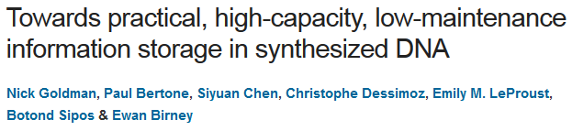
10.000 Years Storage Systesm
How to build a storage system with a mean time to failure = 10.000 years?
Fun read
Uses lots of basic storage system principles
I/O performance not great

Slide 75
Summary
Disk is complex
Disk real density is on Moore’s law curve
Need large disk blocks to achieve good throughput
OS needs to perform disk scheduling
RAID improves reliability and high throughput at a cost
Careful designs to deal with disk failures
Flash memory has emerged at low and high ends
DRAM only storage systems are emerging
Storage hierarchy is complex

